Slide 1

Introduction
Smart Video
Priyanka Bagade
IoT Developer Relations, Intel

Slide 2
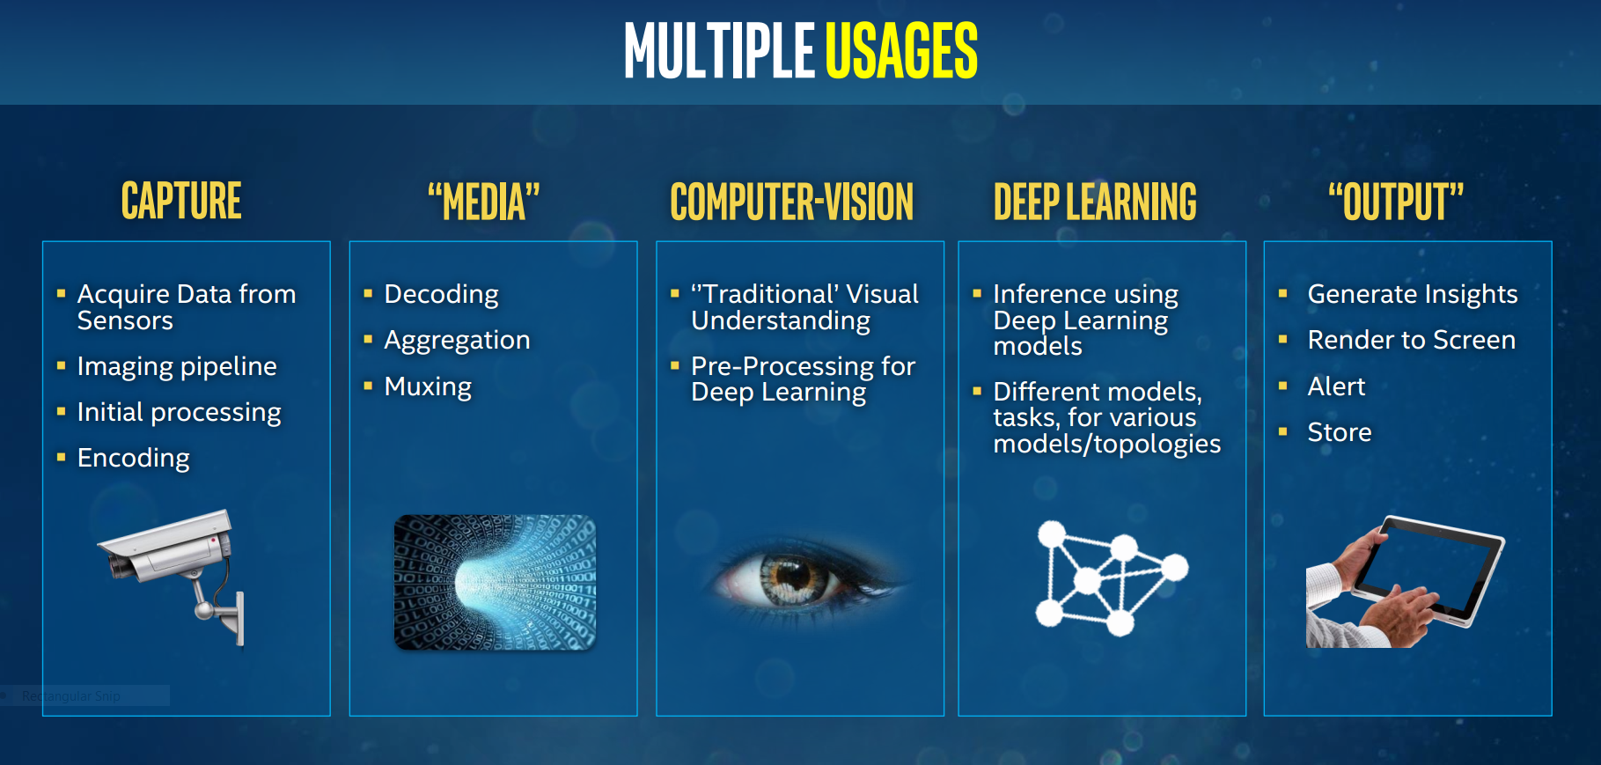

Slide 3
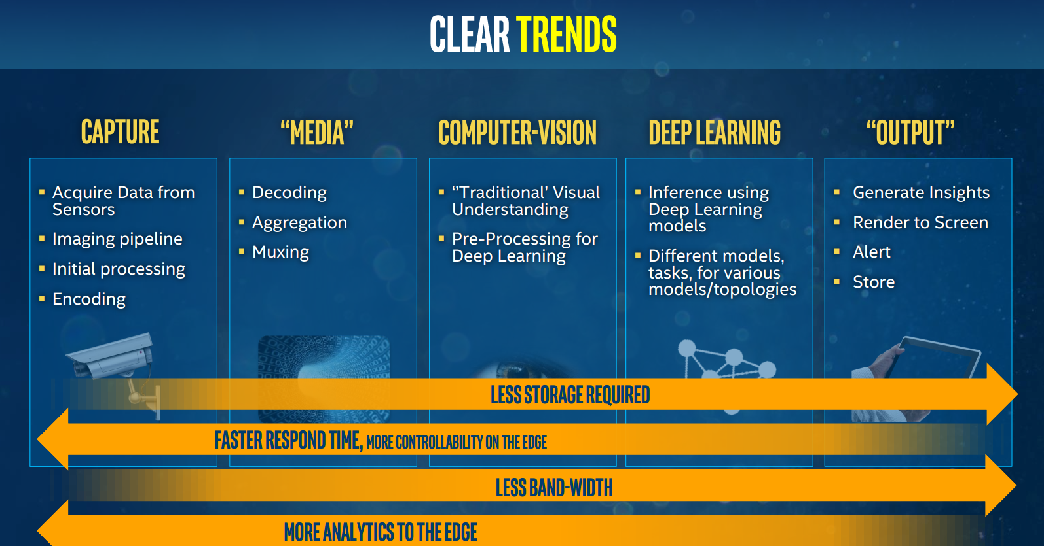

Slide 4
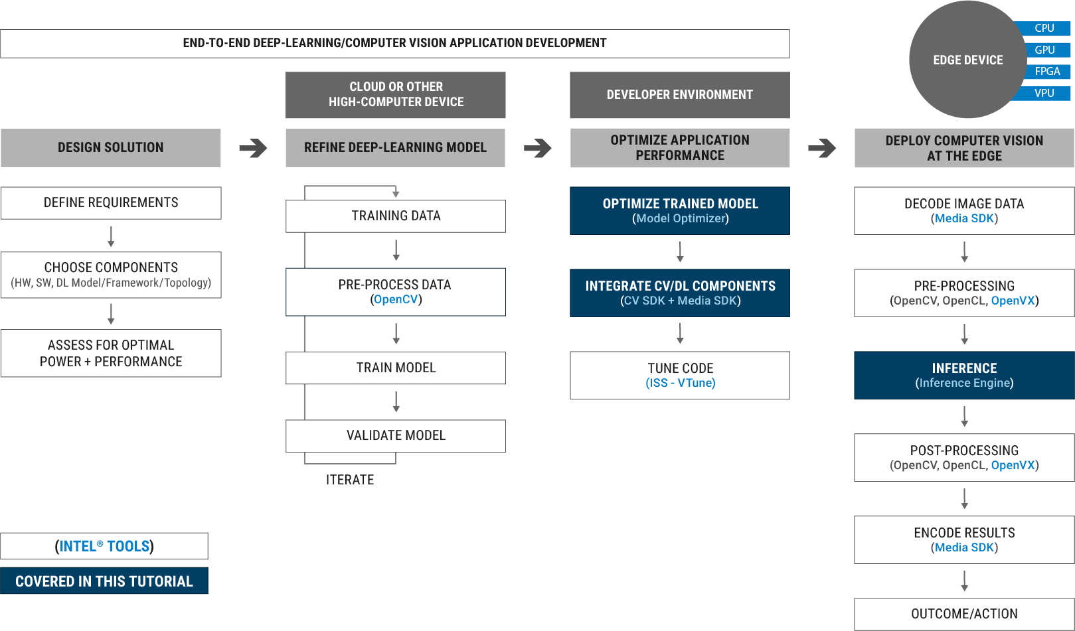
End 2 End CV Application Development Flow

Slide 5
Smart Video tools and Techniques
CV-SDK
Media-SDK
OpenCL
System Studio/VTune
Notes:
CV_SDK – specific property
Media SDK
OpenCL – allows to write custom layers and pipeline filters
System Studio / Vtune
- 4 blocks talking about each of the above tools

Slide 6
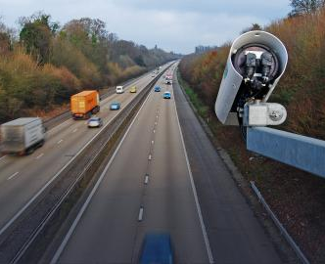

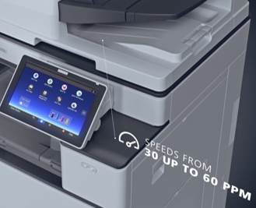

Intel® Computer Vision SDK Beta R3 Accelerate Computer Vision Solutions on Intel® Platforms
What it is
A comprehensive toolkit to accelerate development of computer vision solutions for smart cameras, robotics, autonomous vehicles, & office automation across multiple types of platforms: CPU, GPU, FPGA.
Why important
Demand is growing for intelligent, computer vision & visual understanding solutions, media analytics, & artificial intelligence from edge to cloud.
Users
Software developers
Data scientists interested in neural network inference & deep learning deployment capabilities.
Deliver FAST Copy, Print, Scan PERFORMANCE
Learn More, Download Now: software.intel.com/computer-vision-sdk
Certain technical specifications and select processors/skus apply. See product site for details.
Notes:
the Intel® Computer Vision SDK – is used to accelerate development of computer vision and integration of visual understanding in solutions and applications for autonomous vehicles, smart cameras, robotics, and image processing
It’s important b/c the need for intelligent software is growing and the use of video in enabling those efforts is also expanding
For example think about all the different usages in security cameras and the need for intelligent, immediate smart recognition capabilities like detecting left behind packages, parking lot monitoring, license plate detection, facial recognition…. And more
The computer vision SDK supports these Intel® platforms:
6th generation Intel® Core™ processors
Next-Generation Intel® Atom® processors
Intel® Arria 10GX/FPGA Development Kit

Slide 7
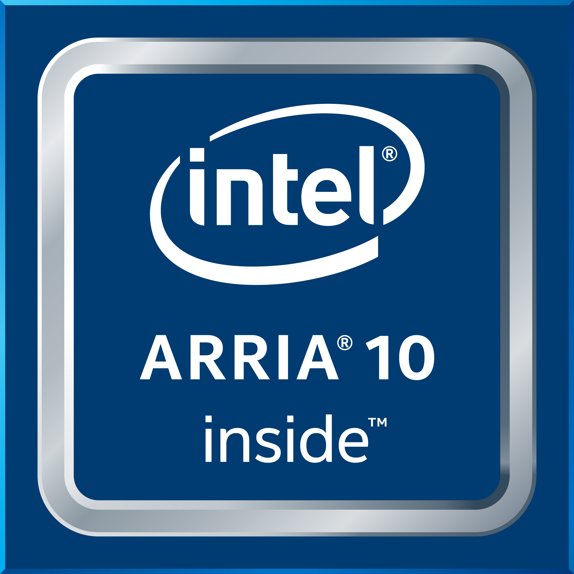
What’s New in Intel® Computer Vision Beta R3
Introduces FPGA Support
Supports Convolutional Neural Network (CNN) workload acceleration on target systems with an Intel® Arria® FPGA 10 GX, where the Deep Learning Deployment Toolkit and OpenVX™ functions deliver inferencing on FPGAs.
Deep Learning Enhancements& New Capabilities for Intel GPU - Provides more usage opportunities:
Adds: 1) additional Caffe* support that delivers near universal single and object recognition in the Inference Engine for high performance and portability; 2) Capabilities and code samples for Neural Style Transfer and Semantic Segmentation topologies; 3) Technical preview: Import capabilities for TensorFlow* and MXNet* framework models in the Inference Engine.
Delivers performance improvements of up to 60+ percent¹ for select topologies (PVANET, Resnet50, Googlenetv3, b32) and batch sizes (SSD_VGG batch 1) with new primitives.¹
Provides an auto-tuning mechanism for choosing the best kernel/primitive implementation for a given Intel GPU.
Traditional Computer Vision Improvements
Provides an enhanced memory footprint performance for OpenVX pipelines.
Supports Khronos OpenVX Neural Networks Ext. 1.2 - is compatible with Ubuntu*, CentOS* and Yocto* OSes when deployed on an Intel CPU.
Create OpenVX applications easier with a new Eclipse* plugin - use a fully integrated development system.
Delivers heterogeneous performance taking full advantage across Intel® processors (CPU, GPU, & New! FPGA).
Get more details about Beta R3 release at: What’s New Blog >
¹Software and workloads used in performance tests may have been optimized for performance only on Intel microprocessors. Performance tests, such as SYSmark & MobileMark, are measured using specific computer systems, components, software, operations and functions. Any change to any of those factors may cause the results to vary. You should consult other information and performance tests to assist you in fully evaluating your contemplated purchases, including the performance of that product when combined with other products. Benchmark Source: Intel Corporation. Optimization Notice: Intel's compilers may or may not optimize to the same degree for non-Intel microprocessors for optimizations that are not unique to Intel microprocessors. These optimizations include SSE2, SSE3, and SSSE3 instruction sets and other optimizations. Intel does not guarantee the availability, functionality, or effectiveness of any optimization on microprocessors not manufactured by Intel. Microprocessor-dependent optimizations in this product are intended for use with Intel microprocessors. Certain optimizations not specific to Intel microarchitecture are reserved for Intel microprocessors. Please refer to the applicable product User & Reference Guides for more information regarding the specific instruction sets covered by this notice. Notice Revision #20110804
OpenVX and the OpenVX logo are trademarks of the Khronos Group Inc.
OpenCL and the OpenCL logo are trademarks of Apple Inc. used by permission by Khronos
Notes:
Delivers heterogeneous performance taking full advantage across Intel® processors (CPU, GPU, & New! FPGA).
FPGA
Developers can learn more about developing for these capabilities, access resources such as a getting started guide, support for CNN, demos, and sample code at Intel FPGA support, and contact your Intel representative.
Customers Share Your Feedback
Intel is also interested in connecting with customers using these new features, and about which FPGA topologies are most needed. Customers are asked to connect with Intel at this public community forum, or by email at isd.support@intel.com.
Deep Learning
We now support ~50+ ~ready-to-go topologies –
New support for Custom layers, fp16 and topology level tuning for Caffe* framework models --- Caffe provides near universal single and object recognition in the Inference Engine for high performance and portability across multiple types of Intel platforms
Technical preview: Adds new import capabilities for TensorFlow* and MXNet* framework models into the Deep Learning Deployment Toolkit Inference Engine. Get more details about these capabilities in the CV SDK documentation.
Eclipse plugin
Capabilities include: creating a new OpenVX project, adding graphs and editing with graph designer, automatic code generation when modifying graphs, and graph profiling and debugging.

Slide 8
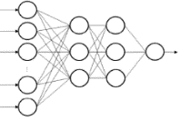
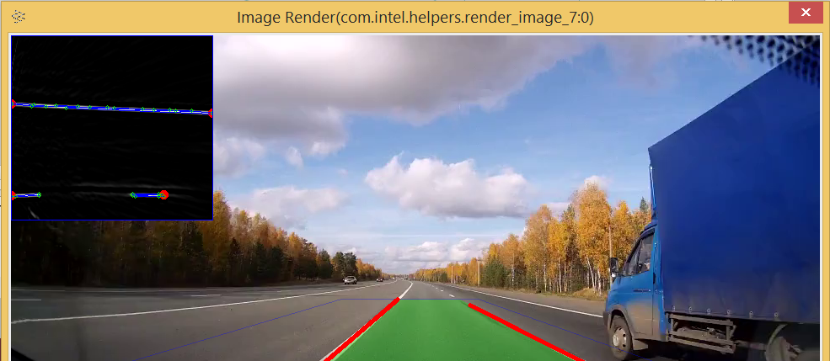
What’s Inside the Intel® Computer Vision SDK Beta
Deep Learning Deployment Toolkit
OpenCV*
Optimized Libraries & OpenVX*
Cross-platform approach to deep learning inference
Optimized
functions for Intel® Processors
Create own customer kernels or use a library of functions
Runtimes, emulator, kernels, workload samples
Enhanced, graphical development using Vision Algorithm Designer
Model Optimizer
Convert & optimize trained models
Inference Engine
Run optimized inferences
Hardware Support
GPU
FPGA
CPU
GPU
CPU
GPU
IPU
CPU
Deep Learning Frameworks
OpenCL™ Driver for Intel® Architecture
Deep Learning Tools from Intel
Notes:
Deep Learning Deployment Toolkit
Inference Engine, with plugins for CPU, GPU and FPGA – what it is… across multi-platform support
Model Optimizer, converting Caffe, TensorFlow, and MXnet to IR. (Note: TensorFlow and MXNet are preview only in R3.)
OpenCV
Pre-compiled OpenCV 3.3
Full Intel CPU optimizations
New Intel Photography Vision Library, with face detection/ recognition, blink detection, and smile detection
OpenVX
Graph-based implementation of a short list of traditional CV operations and CNN primitives.
Khronos OpenVX* Neural Networks Extension 1.2
Visual Algorithm Designer
Eclipse* plugin enabling integrated OpenVX* application development

Slide 9
Key Benefits of the Intel® Computer Vision SDK
Incorporate Deep learning
speed Time-To-Market
Unleash convolutional neural network (CNN) based deep learning inference across Intel processors
Reduce development time with easy-to-use library of computer vision functions
Develop once, deploy across multiple Intel® platforms** from edge to cloud
Accelerate Performance
Innovate & customize
Optimize performance of code across Intel® vision processors (CPU, GPU, FPGA) Supports heterogeneous processing
Use the growing repository of OpenCL™ starting points in OpenCV* to add your own unique code
**Certain technical specifications and select processors/skus apply. See product site for more details.
OpenVX and the OpenVX logo are trademarks of the Khronos Group Inc.
OpenCL and the OpenCL logo are trademarks of Apple Inc. used by permission by Khronos

Slide 10





Target Markets & Use Cases
Office Automation
Optical Recognition
Image Recognition
Print Imaging
Autonomous Vehicles Lane Detection
Object Recognition
Common Use Cases & Workloads
Leveraging a heterogeneous compute environment
Processing images and videos
Managing domain-specific workloads (ie detecting lanes/license plates, parking lot monitoring, face recognition, etc.)

Slide 11


Optimize Computer Vision Performance on Intel Accelerators
Optimized algorithm implementations from Intel across hardware types
Common approach to develop new algorithms across hardware types
Access to GPU capabilities
Computer Vision Processing Optimization Steps
Non-optimized
Code
Input
Intel® Media SDK
Additional Deep Learning Algorithms
DL-Based Modules
Additional Non-Deep Learning Algorithms
Non-DL-Based Modules
Additional Custom Algorithms
Non-DL-Based Modules
Intel -Optimized
Computer Vision Code
GPU Codecs + Frame Processing
Object Segmentation
Deep Learning-Based Modules
Feature Extraction
Library (Non-Deep Learning) Based Modules
Image Enhancement
Custom Code Modules
Intel® Computer Vision SDK Beta
Intel® System Studio
(code optimization)
Pre-trained Optimized Deep Learning Models
API Solution
API Solution
Direct Coding Solution
Deep Learning Deployment Toolkit
Computer Vision Libraries
Custom Code
Intel Hardware Abstraction
Layer
OpenVX™/OpenCV*
OpenCL™
C/C++
GPU
FPGA
CPU
GPU
CPU
GPU
CPU
Leverage Widely-used Development Standards
Notes:
Key Takeaways
Multiple Intel tools (Media SDK, CV SDK, ISS) work together to provide a complete CV pipeline optimization solution
Using CV SDK allows developer to maximize HW performance by using common API without having to go to the Metal
Easy to incorporate deep learning with the Deep Learning Deployment Toolkit

Slide 12
Deep Learning Deployment Toolkit from Intel

Slide 13
Deep Learning Deployment Toolkit Enable full utilization of Intel® architecture Inference while abstracting hardware from developers
Model Optimizer
Imports trained models from popular deep learning frameworks regardless of training hardware
Enhances model for improved execution, storage & transmission
Inference Engine
Optimizes Inference execution for target hardware (computational graph analysis, scheduling, model compression, quantization)
Enables seamless integration with application logic
Delivers embedded friendly Inference solution
Trained Model
Model Optimizer Convert & Optimize
Inference Engine
Run!
Ease of use + Embedded friendly + Extra performance boost
Notes:
In the Beta R2 release
Model Optimizer
TensorFlow*, a deep learning framework, is now supported (partial features apply to GoogleNet V1, V3)
Horizontal fusion support for Caffé

Slide 14
Model Optimizer Features
Model Optimizer
OpenVX™ C Code
Analyze
Quantize
IR Model
Trained Model
Optimize topology
Convert
Accuracy & Statistics Report
Import Models from various frameworks (Caffe*, TensorFlow*, MXNet*, more are planned…)
Horizontal fusion support for Caffe*
Performs quantization by analyzing activations of the network (requires image-set & actual framework)
Performs accuracy feedback (for selective targets by emulation of kernels)
Converts to a unified Model (IR, later Intel® Nervana™ Graph)
Generates OpenVX Code to integrate in OpenVX applications
Includes fusion to OpenVX kernels known
Generated code can be used in the Vision Algorithm Designer for debug
OpenVX and the OpenVX logo are trademarks of the Khronos Group Inc.

Slide 15
Inference Engine Features
Inference Engine Runtime
Simple & Unified API for Inference: Load() → Infer() across all Intel® architecture (IA)
Provides optimized inference on large IA hardware targets (CPU/GEN/FPGA)
Provides inference feedback
Deployed optimized topology
Per layer: Performance, memory, activation overflow
Provides API for saving & loading of a loaded network

Slide 16
End-to-End Machine Learning
1 Train
2 Prepare Model
3 Inference
Real-time Data
Caffe*
Tensorflow*
MXNet*
Model Optimizer
Inference Engine/OpenVX™
MKLDNN
clDNN
DLIA
Trained Model
Optimized Model
CPU
GEN
FPGA
OpenVX and the OpenVX logo are trademarks of the Khronos Group Inc.

Slide 17

Teaching Developers to build Digital Signs
Visual Retail Customer Requirements
HD quality digital signage in Retail store
Real-time analytics
Easy system upgrade
Intel® Media SDK Overview
(highlevel)
Decode
Process
Encode
We provide hands-on workshops that show developers how to enhanced Video performance with Intel® Media SDK
Equips developers with a standard API to create high-performance video solutions.
Provides easy access to hardware acceleration with Intel-optimized software fallback.
Improved productivity with optimized routines for delivering maximum video performance for decoding, encoding and frame processing tasks.
Supports built-in future proofing of video applications for upcoming platforms.
Notes:
The visual retail customers require high performance video solutions with faster response time in the retail store for various marketing activities.
We introduced Intel® Media SDK to developers in our workshops in order to develop such solutions with highly optimized routines for Intel hardware.
Intel® Media SDK provides a standard set of APIs to create high performing video solutions. Both customers and professionals can take advantages of it.
Intel® Media SDK supports 3 main tasks for any video processing, decode, encode and frame processing with hardware acceleration. These tasks are highly optimized for Intel hardware. Thus developers do not need to worry about their performance.
If hardware acceleration is not possible on the device, then MediaSDK would fall back to software acceleration. It will ensure to explore all possible options to enhance the video processing performance and give better user experience.
It also provides the flexibility to developers to add their own custom codes as needed.
Since MediaSDK takes care of all performance optimizations, the development team can focus fully on feature innovations of the product rather than worrying about performance. Built in future proofing, which means that the solution build today with media SDK, it is guaranteed to work with future Intel hardware as Intel takes care of all enhancements and code migrations that are need.
These features of Intel® Media SDK allows developers to easily build high performance solutions for visual retail with hardware acceleration on Intel platforms.

Slide 18
Media-SDK

Slide 19
OpenCL

Slide 20
System Studio / Vtune

Slide 21
Smart video Workshop Overview
Introduction
2. Basic End to End Object Detection Example
Classification
Introduction to Intel® technologies for deep learning inference
Hardware acceleration techniques
H/W Acceleration
3,4,5. HW Acceleration with CPU, Integrated GPU, Intel® Movidius™ NCS, FPGA
Each Module contains a hands-on lab exercise that will introduce to various Intel technologies to accelerate computer vision application with hardware heterogeneity.
6. Optimization Tools and Techniques
Optimization
7. Advanced Video Analytics
Application

